Slide 1


Transitioning to "What's Next"

Slide 2

Transition planning
A structured process designed to ensure that students with disabilities are prepared for life after high school. It’s an essential component of the special education system to equip students with the skills and knowledge they need to move into post-secondary education, vocational training, employment, independent living, or other avenues of adult life.

Slide 3

Navigating a maze
When a child is diagnosed with a disability, parents often find themselves navigating a maze of medical, psychological, and educational jargon, treatments, therapies, and services. Mainly they are focused primarily on their child’s immediate needs and current academic progress. With these pressing concerns, the long-term transition planning process may not even be on their radar.

Slide 4
The future
The future can also be a source of anxiety for many parents and caregivers of children with disabilities. They might be worried about their child’s ability to live independently, secure employment, or attend post-secondary education. As a defense mechanism, some parents may avoid thinking about or discussing the future, inadvertently overlooking the importance of planning for their child’s transition into life after high school.

Slide 5

Cultural and societal factors
Additionally, cultural and societal factors can play a role in the lack of awareness of the need for transition planning. In some cultures or communities, there may be a lack of understanding of disabilities in general, let alone the importance of strategically planning a process to ensure their child is able to transition successfully into adult life. Parents from these backgrounds might not have access to the information or resources needed to inform and explain the significance of transition planning.

Slide 6
Schools need to emphasize planning
In some cases, the schools or educational institutions might not emphasize transition planning as much as they should. Not all educational settings have the same resources, training, or priorities, and transition planning might not be as robust or as well-communicated in some places compared to others. This lack of communication can leave parents unsure about where to start or what to prioritize, leading to potential oversights regarding the planning process.

Slide 7
Agenda
By understanding some key aspects of transition planning, parents can advocate for and support their child in preparing for a fulfilling and productive life beyond school
Ongoing process
Person centered and personalized approach
Multiple areas of life
Collaboration is key

Slide 8
Ongoing process – Not a One-time event
Transition planning is not something that happens once and is then forgotten. It’s an ongoing process that evolves as the student grows and their needs and goals change. Regular reviews and adjustments to the transition plan ensure it remains relevant and effective, paving the way for the best possible outcomes for the student in adulthood.

Slide 9
Person-Centered and Individualized Approach
Every student’s needs, strengths, preferences, and interests are unique. Transition planning is not a one-size-fits-all process. It is crucial to involve the student in the planning, ensuring that goals and strategies align with their aspirations, interests, and abilities. This helps in making the transition as smooth and effective as possible

Slide 10
Addresses Multiple Areas of Life
Transition planning isn’t just about academics or employment. It encompasses various life areas, including post-secondary education, vocational training, independent living skills, community participation, and, if relevant, managing health and personal care. Comprehensive planning looks at the whole individual, ensuring they are prepared for all aspects of adult life.

Slide 11
Collaboration is key
Successful transition planning is a collaborative effort. It involves the student, parents, educators, school counselors, vocational rehabilitation professionals, and sometimes other agencies or community members.
Everyone has a role in helping students achieve their post-secondary goals, and open communication among all stakeholders is crucial.

Slide 12
Transition journey map
We have created a Transition Journey Map to get you started and introduce you to some key transition planning concepts that we hope will make the process a little easier for you.

Slide 13
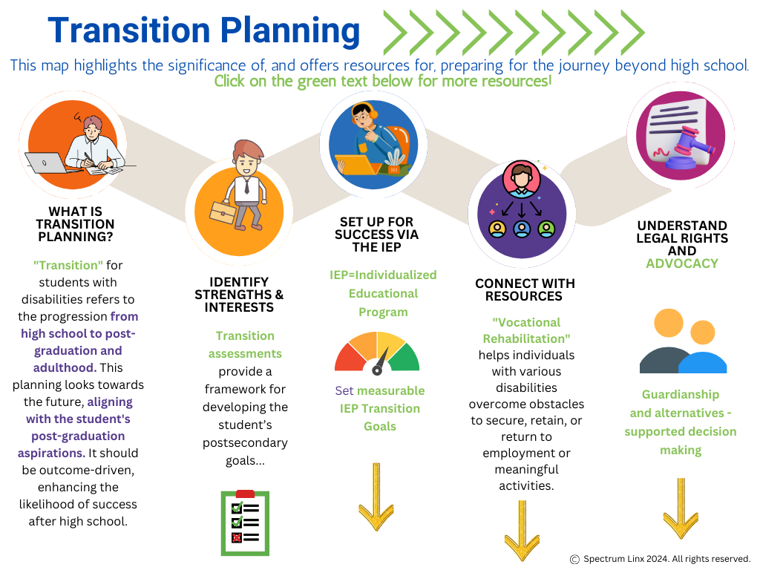

Slide 14
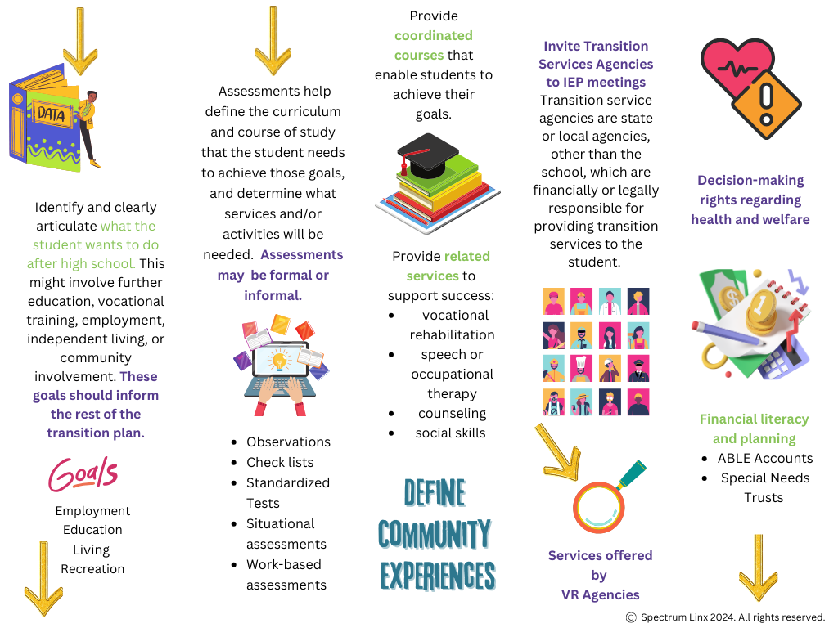

Slide 15
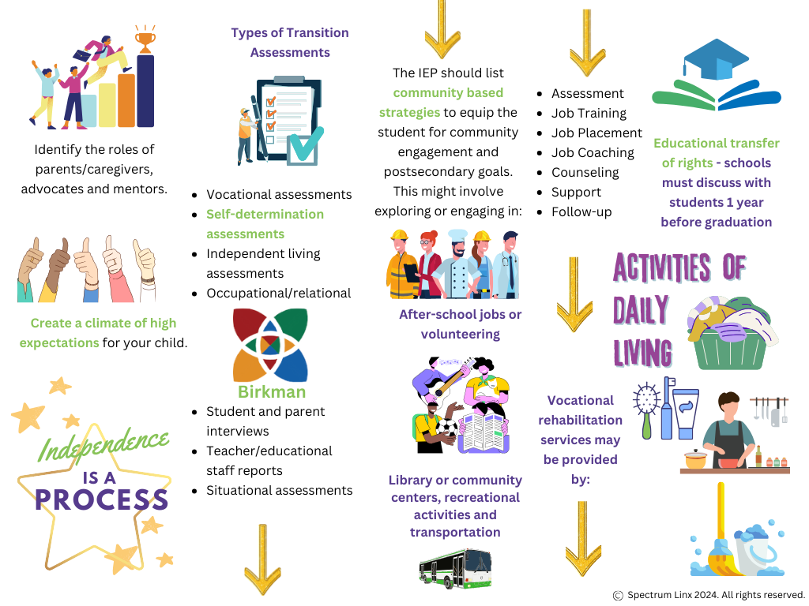

Slide 16
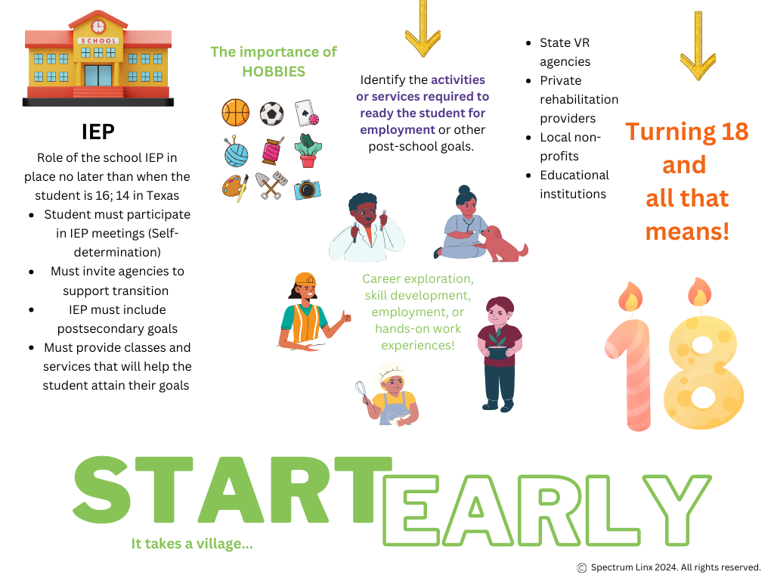

Slide 17

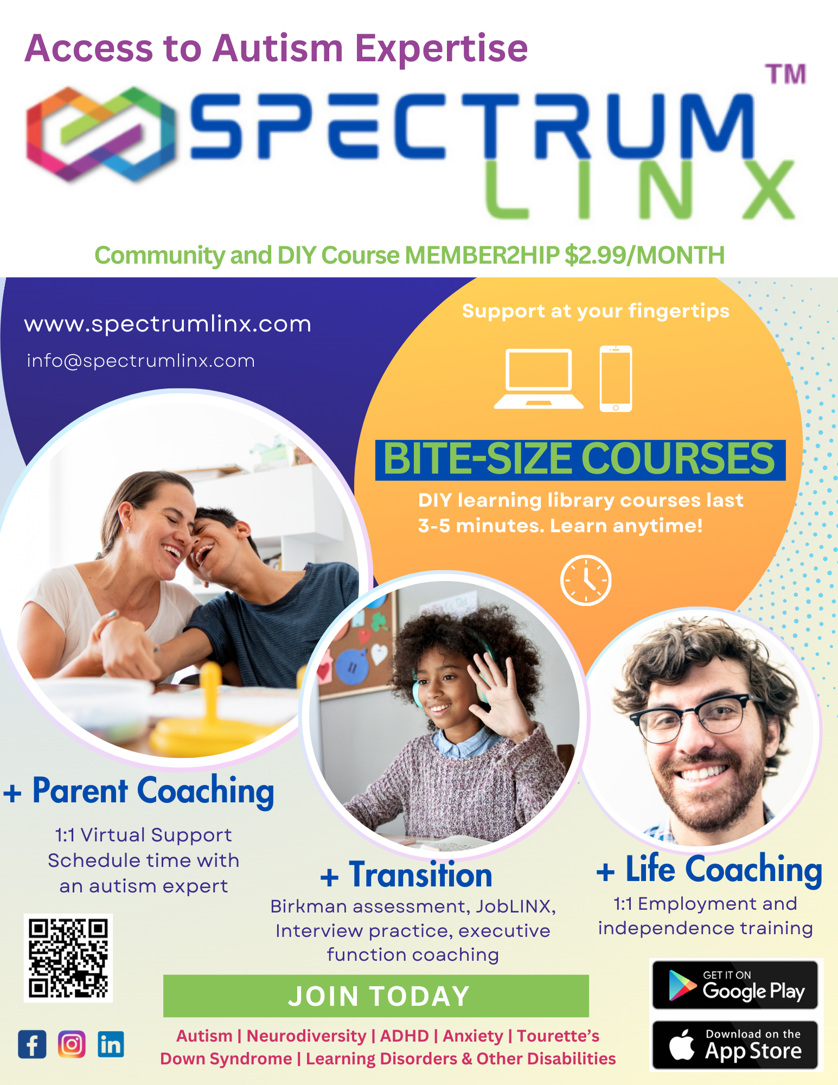


Slide 18
Thank you
Wendy Dawson Co-Founder - CEO
Brandi Timmons Co-Founder M. Ed., BCBA, LBA
281-826-6020
info@spectrumlinx.com
www.spectrumlinx.com
Spectrum Linx app – in the Google and Apple Store

